Slide 1
Problem Identification
Big Mountain Resort is seeking to improve its ticket pricing strategy to ensure it aligns with the market value of its features compared to competitors, addressing concerns of undercharging and revenue optimization.
The resort is considering operational changes, like modifying run lengths and capacities, and needs to understand their impact on pricing and revenue.
An effective pricing strategy will enable Big Mountain to maximize revenue while maintaining its appeal in the market.

Slide 2
Recommendation & Key Findings
The model suggests that Big Mountain Resort could increase its ticket price, potentially up to $95.87, considering its impressive amount of fast quads and runs, as well as its elite vertical drop and snowmaking coverage, compared to its competitors.
Closing underused runs shows minimal impact on pricing, whereas expanding the vertical drop and adding a chairlift supports a price increase.
The analysis does not support significant investment for extending the longest run or minor increases in snowmaking area, as these changes will not create substantial support for a ticket price increase.

Slide 3
Modeling Results & Analysis
Our predictive modeling utilized a Random Forest Regressor to determine the market-supported ticket price based on various resort features.
By examining resorts nationwide, our model achieved a mean absolute error of approximately $10.39, indicating strong predictive capabilities.
Key features such as vertical drop, snowmaking area, total chairs and amount of fast quads significantly influenced the predicted ticket prices, showing their value in the market.

Slide 4
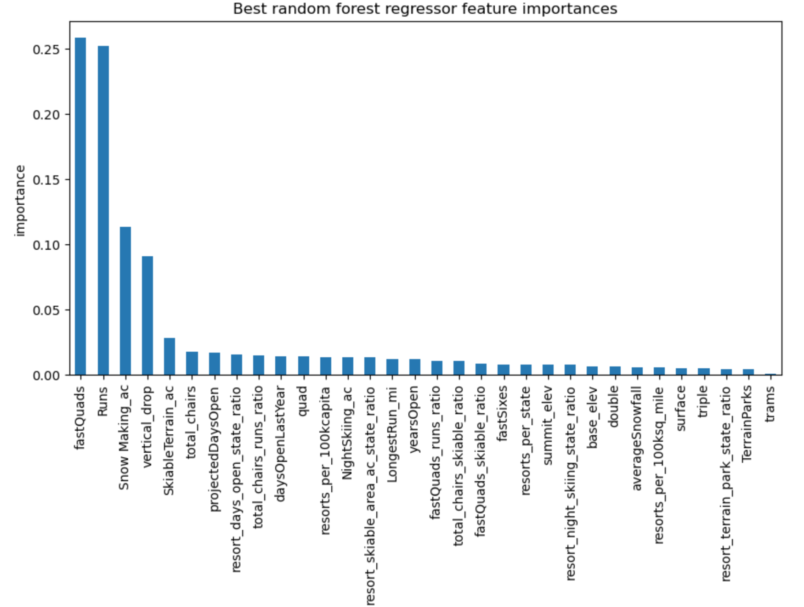

Slide 5
Modeling Results & Analysis continued
We conducted several scenario analyses to understand the potential impacts of various changes at Big Mountain Resort. For instance, increasing the vertical drop and adding a chair lift could justify a ticket price increase of $1.99, leading to increased seasonal revenue.
Our model also showed minimal to no price support for closing less popular runs or small increases in snowmaking.
These insights show the importance of strategic investments and resource allocation in order to increase resort appeal and profitability.

Slide 6
Summary & Conclusion
Our comprehensive analysis indicates that Big Mountain Resort should adjust its ticket pricing to better reflect the value offered by its prominent features.
The recommended ticket price increase is supported by the resort’s competitive advantages, such as its extensive snowmaking capabilities, fast quad/ run amount, and substantial vertical drop, which are highly valued in the market.
Implementing these changes could improve revenue without significantly impacting visitor numbers.
This strategic adjustment is an essential step toward optimizing the resorts financial performance while maintaining a positive visitor experience.

